Slide 1
Recreation of High-Density SNP Genotyping of Tomato Reveals Patterns of Genetic Variation Due to Breeding
PEB Power:
Matthew Dzievit, James McNellie, Jinyu Wang, Therin Young
BCB 546X – Spring 2017

Slide 2
Introduction
Array-based genotyping platforms permit rapid scoring of several thousand markers in parallel
SolCAP germplasm → 426 accessions (141 processing, 110 fresh market, 61 vintage, 27 cultivated cherry, 12 landrace, 43 wild cherry, 16 S. pimpinellifolium, and 16 hybrid)
SolCAP array → 7,720 SNPs used to genotype the SolCAP germplasm. Subsets of markers were selected using the genetic map positions determined from two bi-parental populations: EXPEN 2000 (3,503 markers) and EXPIM 2012 (4,491 markers).
Notes:
SNP data from such arrays can also be a resource for germplasm management in breeding programs and has a role in genomic selection strategies for crop improvement.

Slide 3
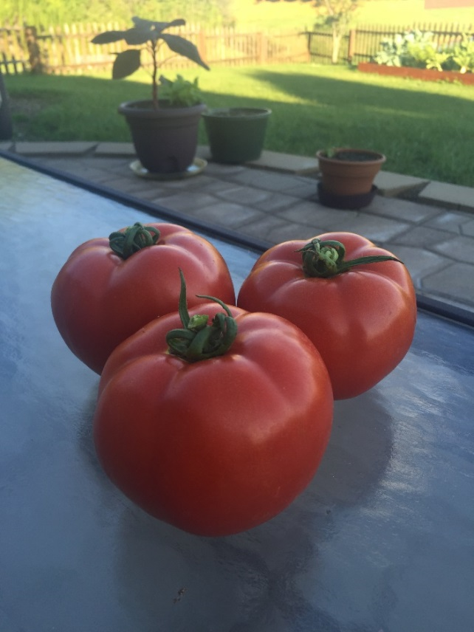
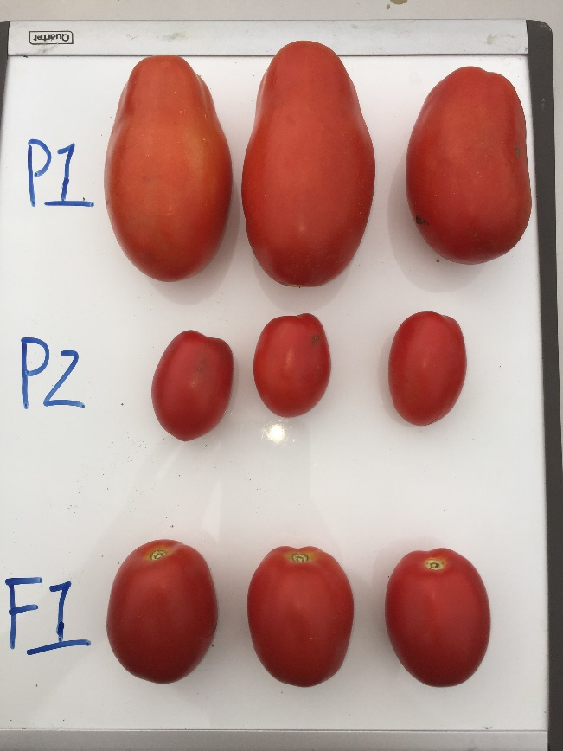
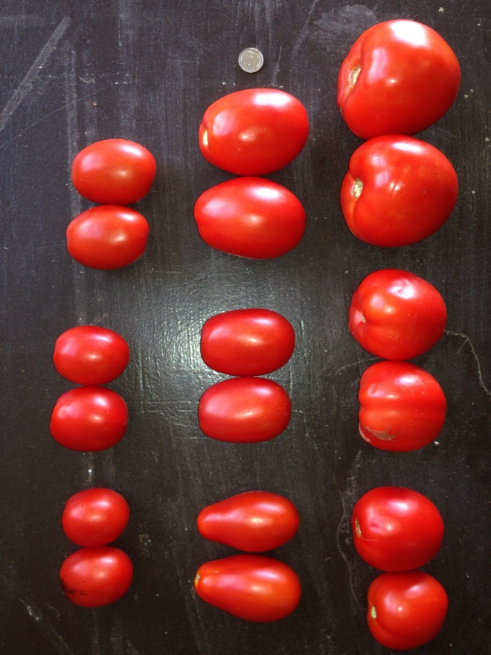
Fresh Market, Processing, and Grape Tomatoes
Breeding for distinct market classes has led to genetic differentiation in contemporary germplasm
Processing cultivar (P1)
Grape cultivar (P2)
Fresh Market cultivar
Multiple types of cultivars
Notes:
Processing and field-grown fresh market tomatoes are now distinct sub-populations
Left hand side is an example of fresh market
On right hand side P1 is a processing cultivar, P2 a grape cultivar

Slide 4
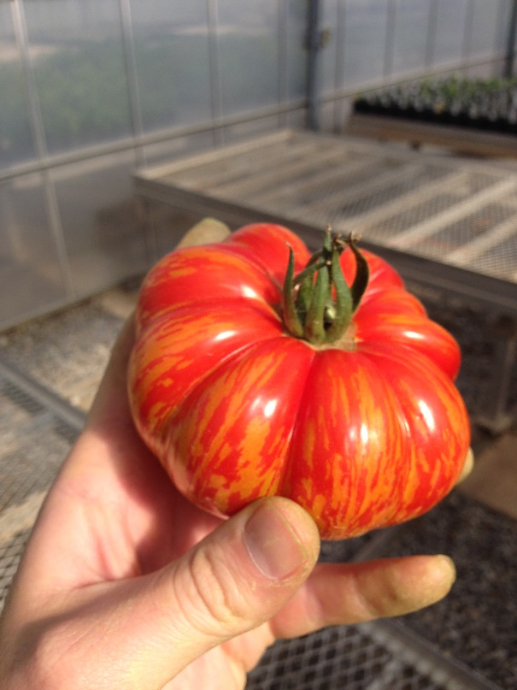
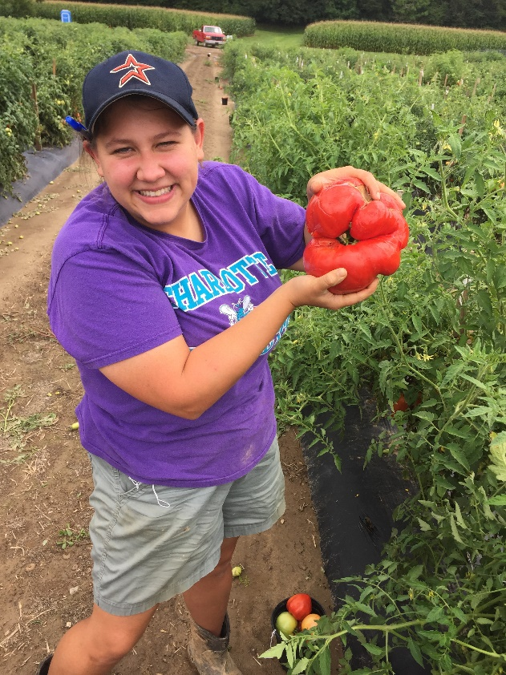
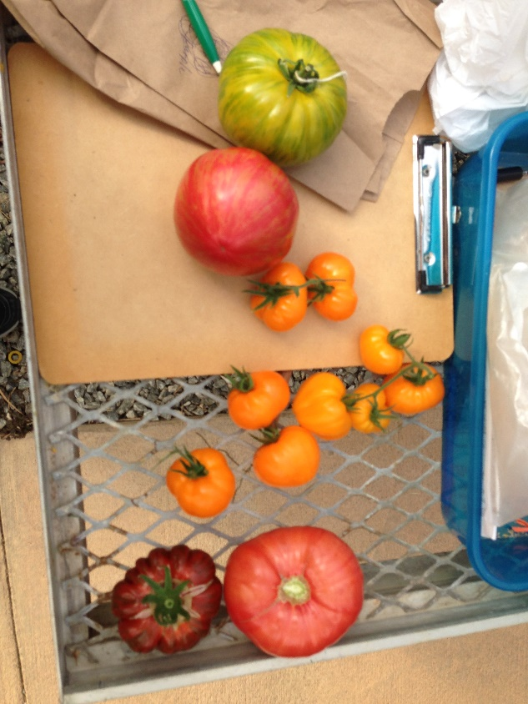
Retros (aka Vintage)

Slide 5
Objectives
Investigate genetic variation on the tomato genome due to contemporary breeding
Conduct population level analysis based on the germplasm panel
Identify sub-populations by analyzing SNP genotypes from the array
Investigate patterns of linkage disequilibrium (LD) within each chromosome in three subpopulations (processing, fresh market, and vintage)

Slide 6
Overview of workflow
Pre-processing of the data: Unix
Investigate and clean up the data
Remove unnecessary information
Filter SNPs for missing data
Final data matches format presented in paper
Recreate figure 1: Use pre-processing data and R
Recreate figure 3A/4A : Use pre-processing data with unix, perl and R
Recreate figure 5/6/7: Use pre-processing data and R

Slide 7
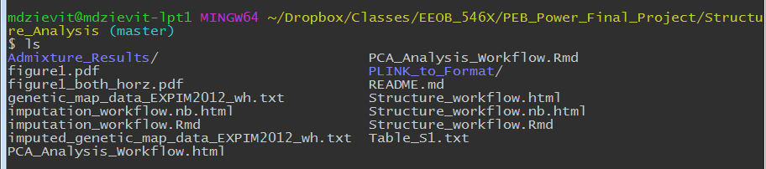
Overview of documentation
Every folder contains a README files describing the files and/or subfolders located within a given folder
All scripts are accompanied by markdown files or are R notebook files with annotation and comments imbedded

Slide 8
Recreate Figure 1: Overview of workflow
Utilized pre-processed data provided by group
Filter out hybrids and then subset data into processing genotypes
Imputed missing data
Paper mentioned package in R, but no code or indication of parameters they used. Needed to guess
Format data to run PCA using base R package
Plot the data using codes
- Market class they provided was post analysis vs. pre and post analysis

Slide 9
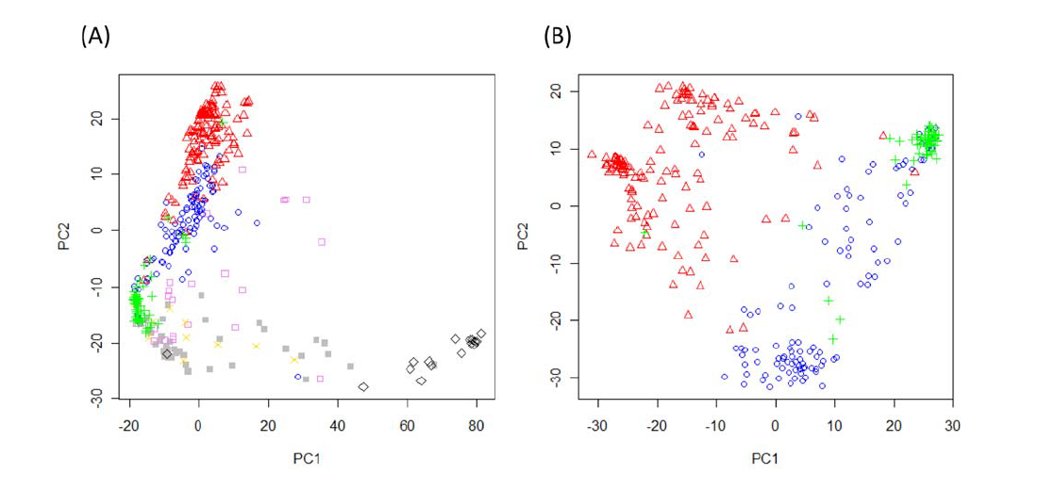
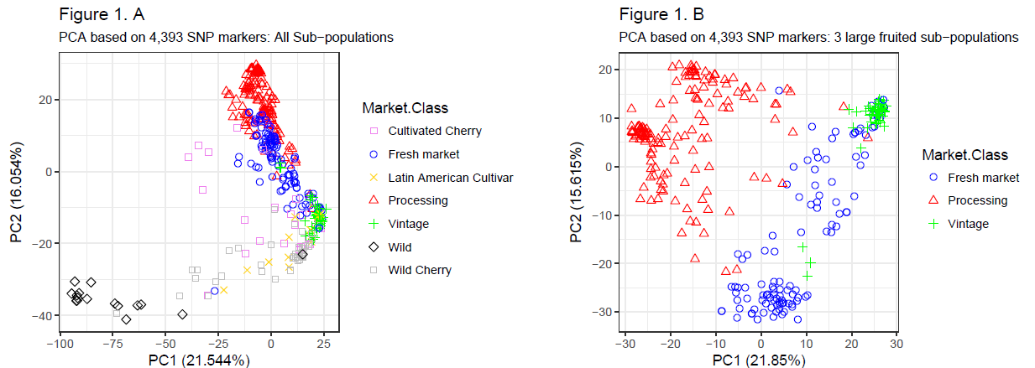
Recreate Figure 1: Results
ORIGINAL
Sim et. al, 2012
Recreated

Slide 10
Confirm results w/Structure Analysis: Overview of workflow
Extra work not done in paper!
Utilized formatted data provided by group
Filter out hybrids and then subset data into processing genotypes
Convert genotype data file into .ped format (plink, Purcell, et. al 2007, Amer. J Human Gen)
Use plink to convert files to .bed format
Send .bed files to linux server to run Admixture (Alexander, et. al 2009, Genome Research)
Import .Q files into R for data manipulation

Slide 11
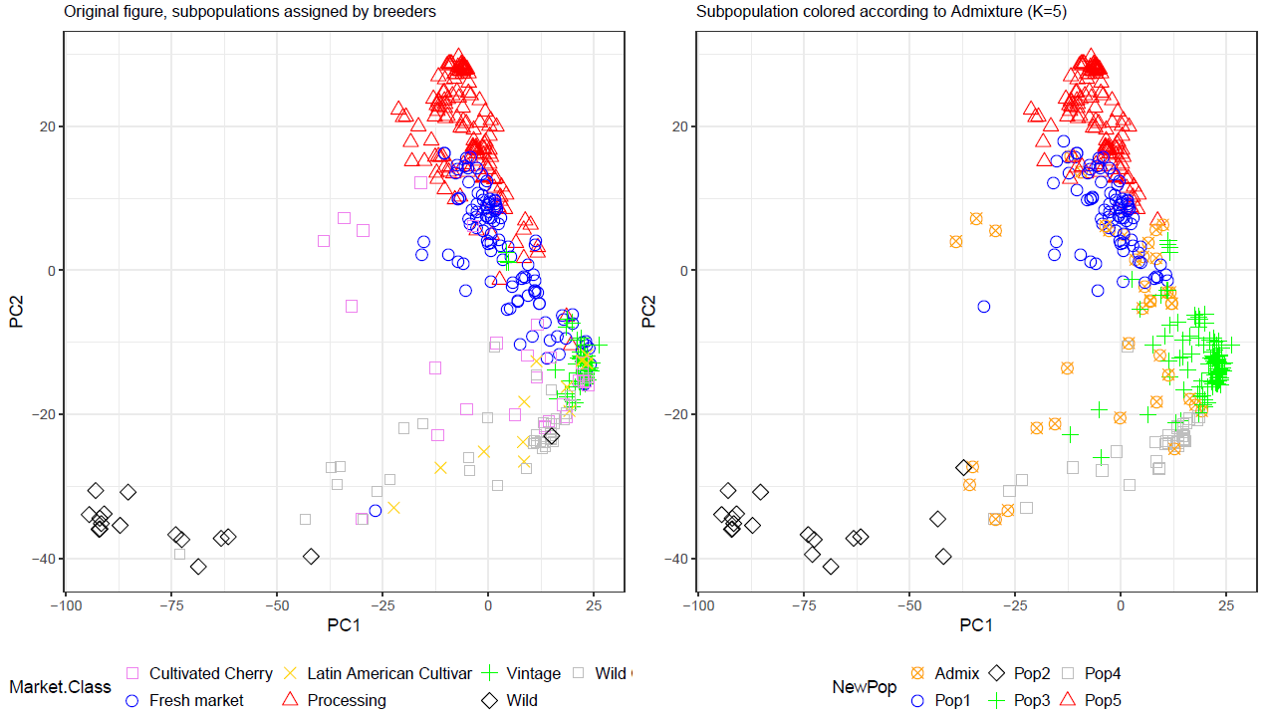
Confirm results w/Structure Analysis: Results: Full Dataset
Extra work not done in paper!

Slide 12
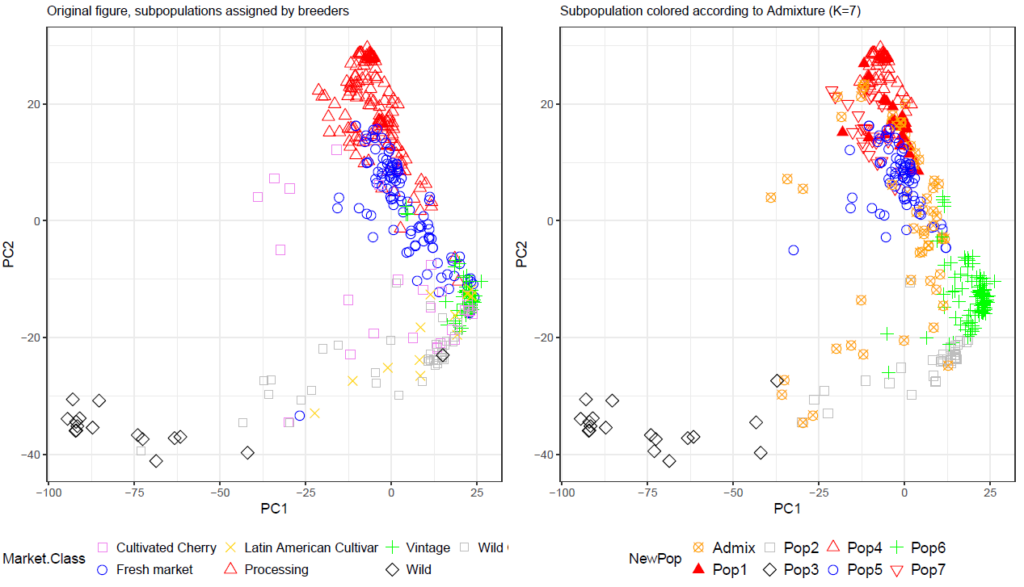
Confirm results w/Structure Analysis: Results: Full Dataset
Extra work not done in paper!

Slide 13
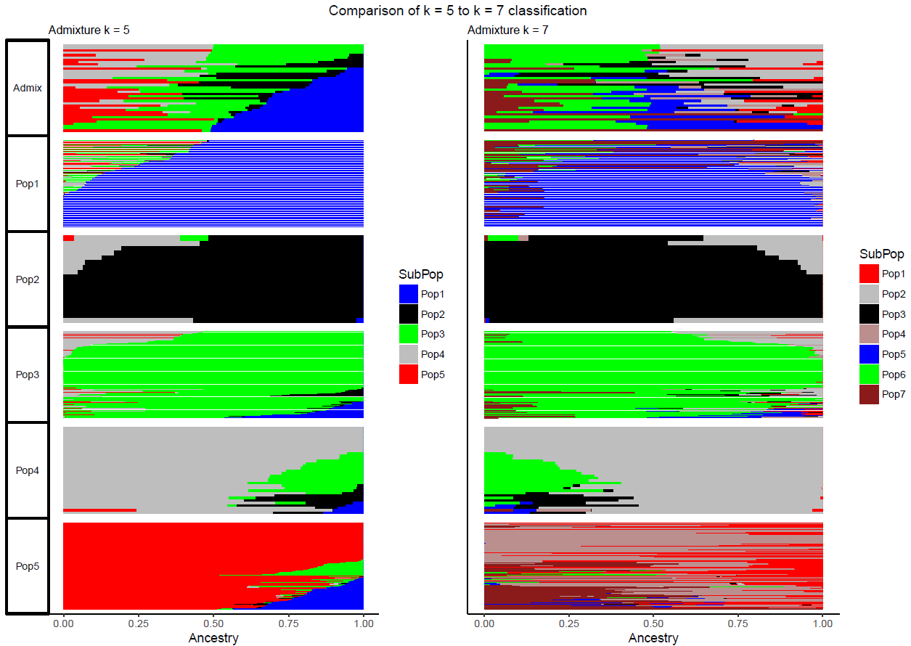
Confirm results w/Structure Analysis: Results: Full Dataset
Extra work not done in paper!

Slide 14
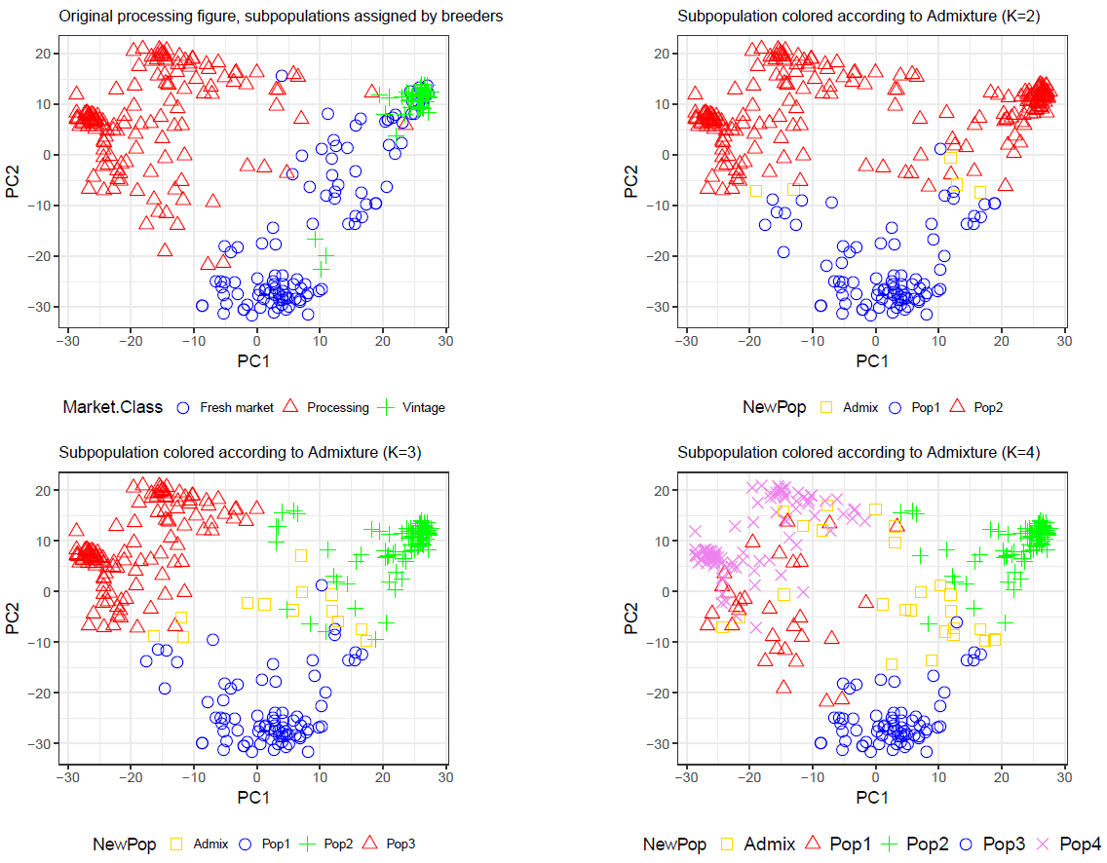
Confirm results w/Structure Analysis: Results: Processing Dataset
Extra work not done in paper!

Slide 15
Take home message
Structure (via admixture) analysis generally matches the a priori classification by the breeders
Genotypes that don’t match are cases where genetically they are more similar to one particular sub-population, however, they may contain a few key genes that make them phenotypically similar to another sub-population
With modern breeding material it is useful to look at population structure analyses using genotypic data, however, it is important to make sure that these sub-population classifications match the breeder’s knowledge/expectations

Slide 16
Recreate Figure 3A and Figure 4A
Figure 3A: Minor allele frequency (MAF) patterns on chromosomes 1 to 6 for each of four subpopulations
Figure 4A: Minor allele frequency (MAF) patterns on chromosomes 7 to 12 for each of four subpopulations
Object: visualize the genetic variation between three representative sub-populations of cultivated tomatoes (processing, fresh market, vintage) along with S.pimpinellifolium accessions

Slide 17
Recreate Figure 3A and Figure 4A
Work flow
Use formatted data provided by group members
Filter out 16 hybrids accessions, work with the remaining 410 inbred accessions in Unix
Determine minor allele for each SNP site based on genotypic data of 410 inbred accessions in Perl
Subset data for each of the four sub-populations in Unix
Estimate MAF within each sub-population in Perl
Check the correlation between regenerated MAF with the MAF on the paper
Graph the MAF of four sub-populations using R package ggplot2

Slide 18
Check the correlation between regenerated MAF with the original MAF on the paper

Slide 19
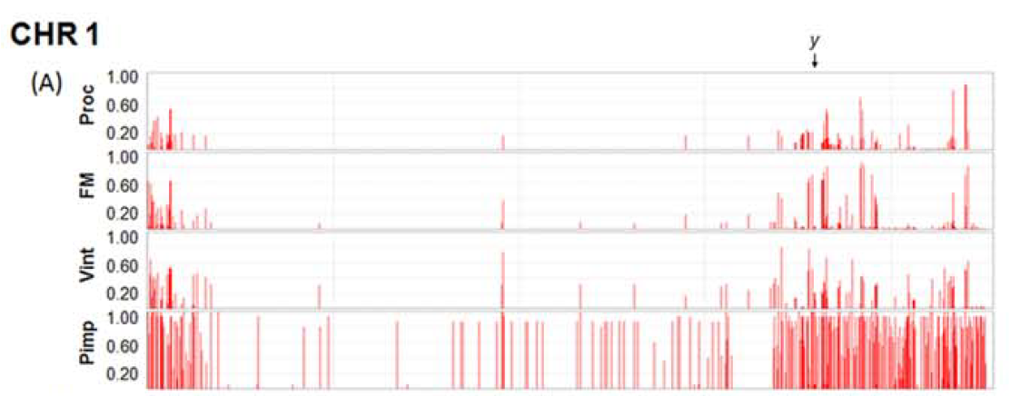
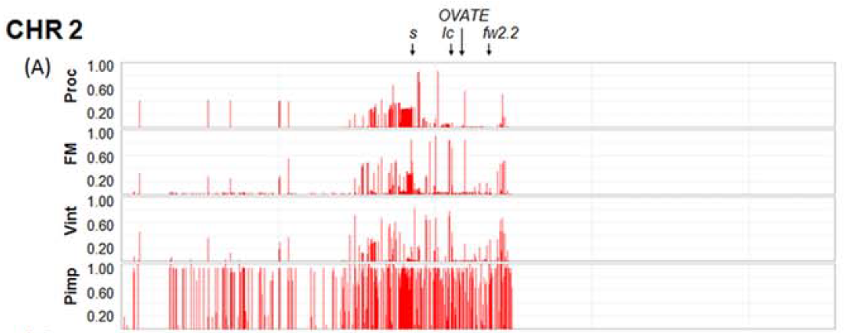
Recreate Figure 3A
Original
Recreated

Slide 20
Recreate Figure 3A
Original
Recreated

Slide 21
Recreate Figure 4A
Original
Recreated

Slide 22
Recreate Figure 4A
Original
Recreated

Slide 23
Recreate Figures 5, 6, & 7
Objective: Plot LD decay for 3 sub-populations (processing, fresh market and vintage) with two trendlines; locally weighted scatterplot smoothing (LOESS) and non-linear regression (NLR)
Sim et al. (2012) calculated LD in Tassel and created the graph the in R. I used the R package ‘LDheatmap’ to calculate LD
Sim used a smoothing parameter of 0.3 for LOESS
I used ‘span = 0.9’
The “model of Hill and Weir” was used to calculated NLR
I used a script I found online: https://fabiomarroni.wordpress.com/2011/08/09/estimate-decay-of-linkage-disequilibrium-with-distance/

Slide 24
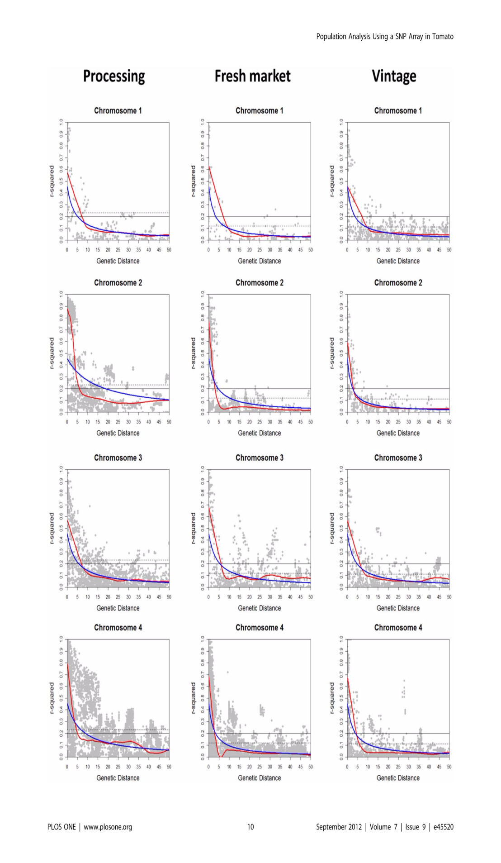
Sim et al. 2012

Slide 25
Sim et al. 2012

Slide 26
Sim et al. 2012

Slide 27
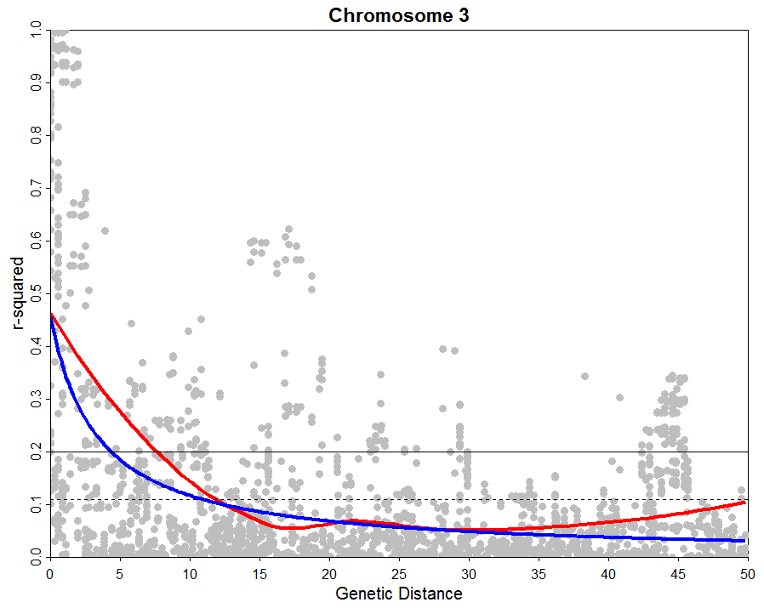
Vintage
Sim et al. 2012

Slide 28
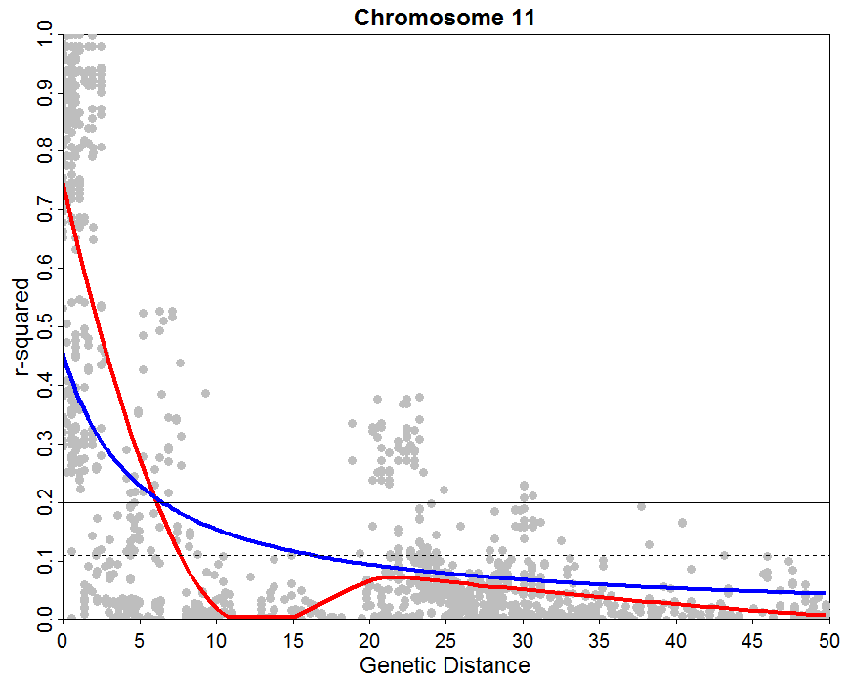
Vintage
Sim et al. 2012

Slide 29
Summary
Overall, we were able to recreate the figures from the paper
Steps were not clearly documented with specific parameters used for the different packages/procedures
Data files were presented post analysis, would have liked to also have the data files pre-analysis to fully recreate their analysis
- i.e. Germplasm classified into 5 sub- populations, after analysis classified into 7

Slide 30
Thank you! Questions?

